Slide 1
Thread Factory
Almost there

Slide 2
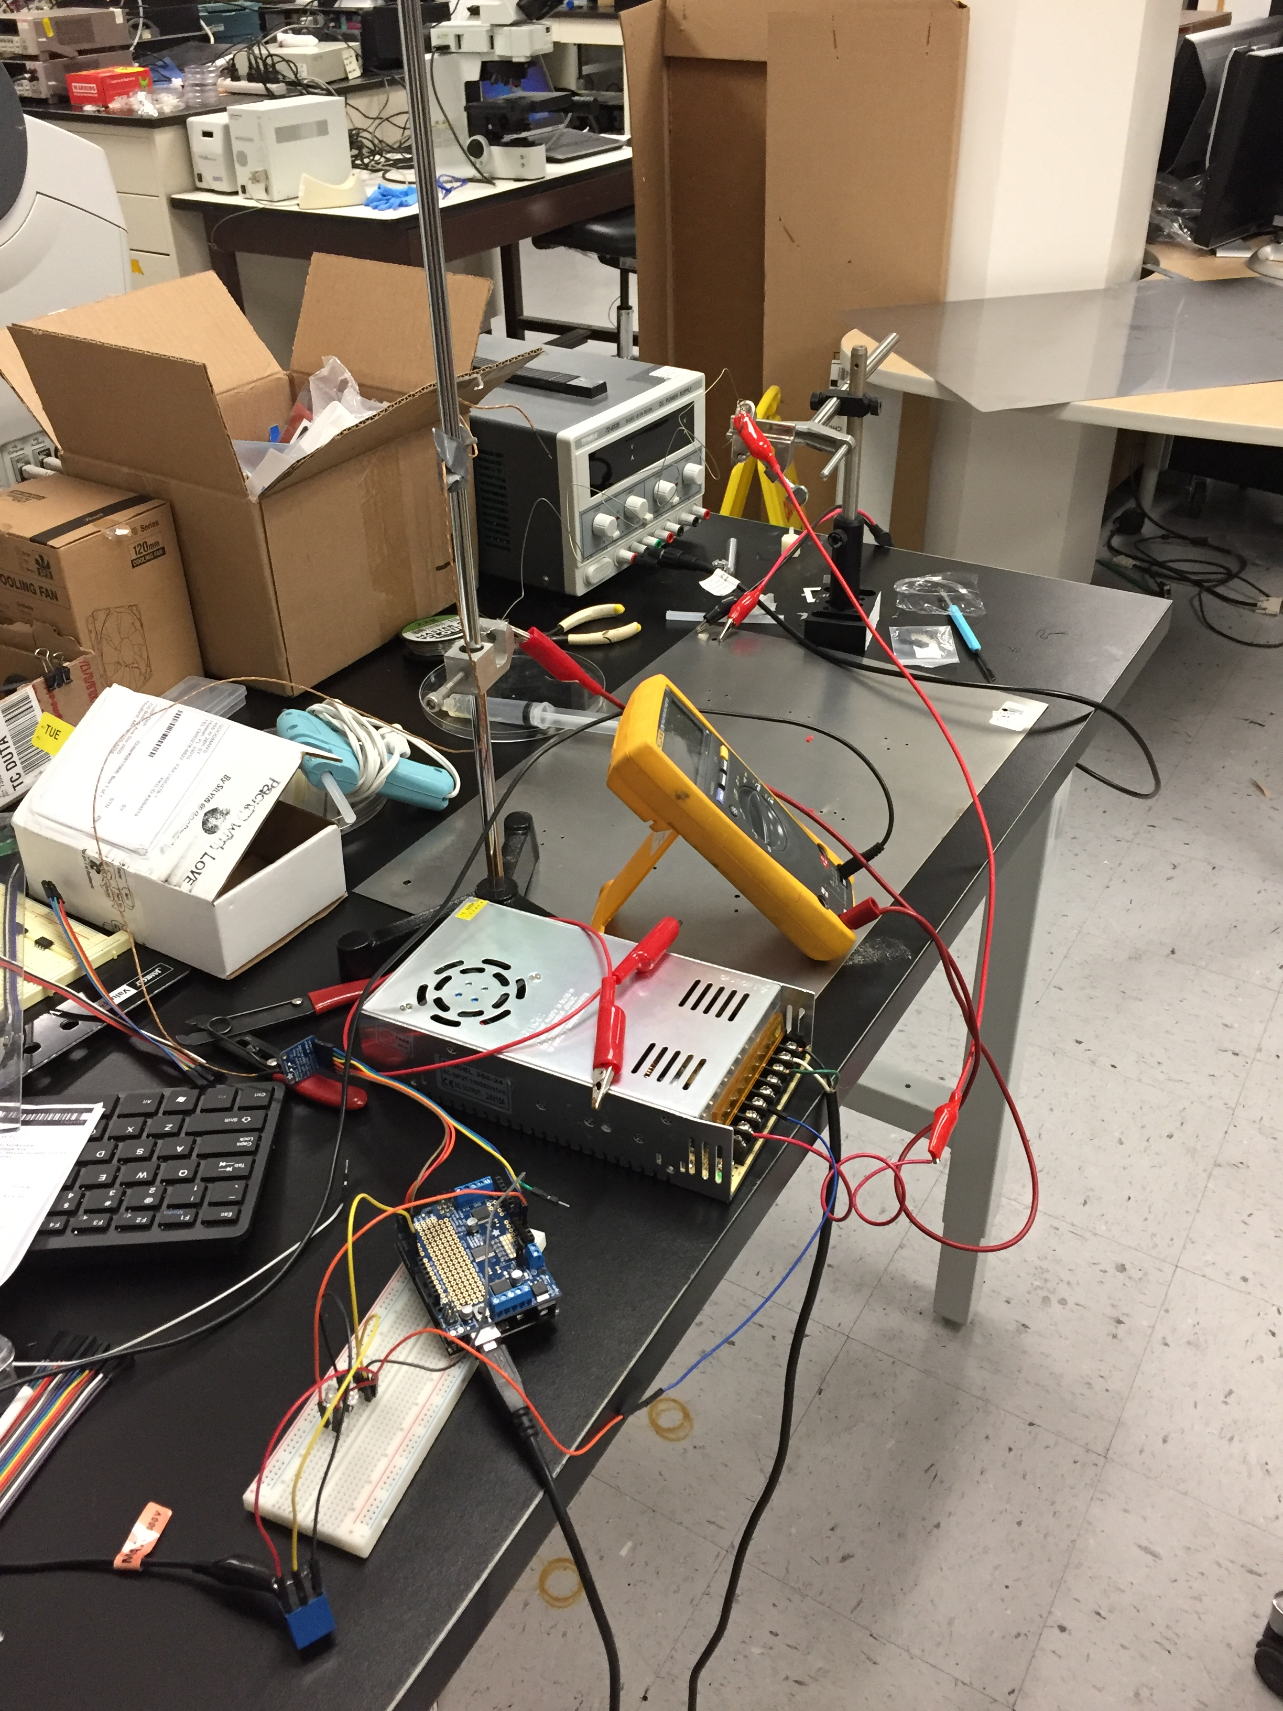
Heating works! (rudimentarily)
Heavy duty wires
PID Arduino code
Cut and form enclosure (Tuesday)
Install nichrome inside enclosure
Power supply
relay

Slide 3
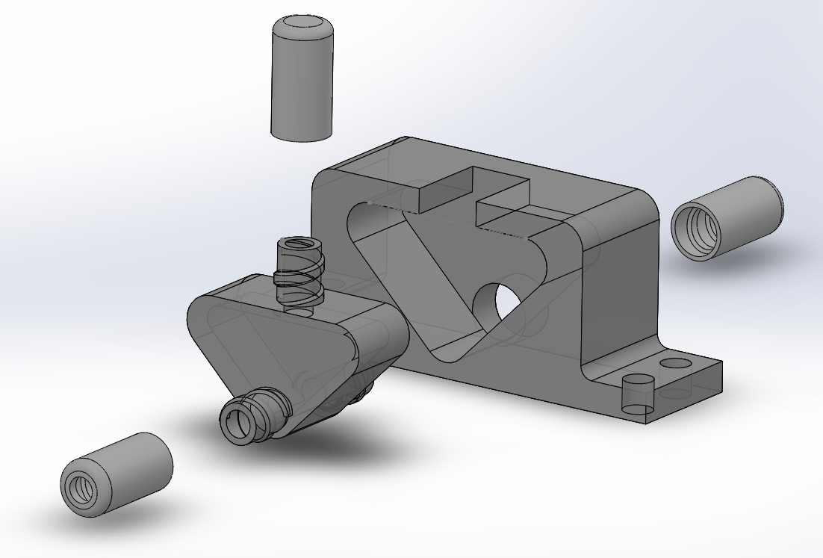
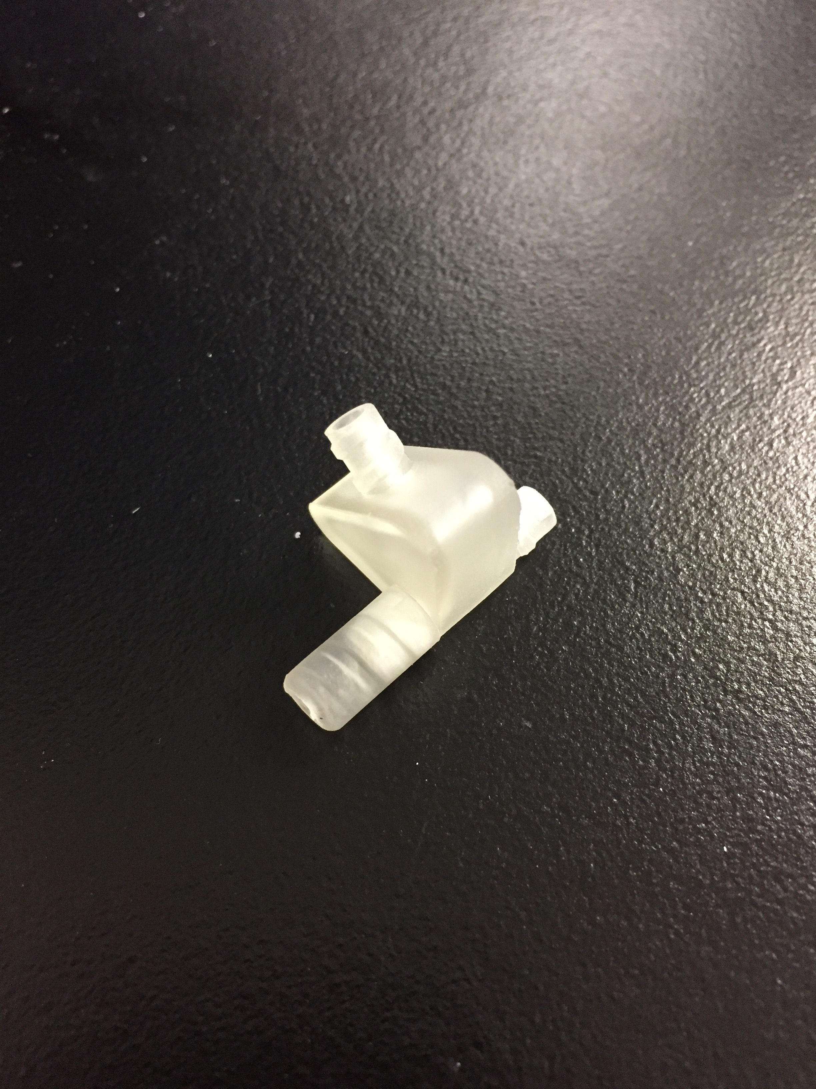
Ink Cartridge

